Slide 1
The Data Management Lifecycle (in 5 minutes)
Catarina Pien
Bureau of Reclamation
IEP Workshop | April 18, 2024
Notes:
Short overview of all the steps of the data lifecycle.

Slide 2
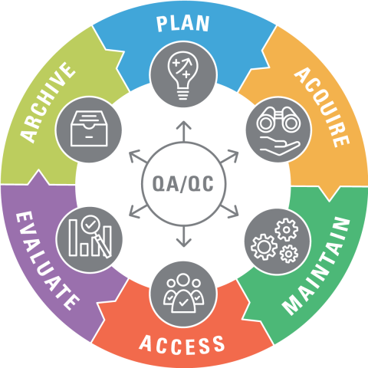
Data Management Lifecycle
Data Management Life Cycle | U.S. Fish & Wildlife Service (fws.gov)
Notes:
Here is the data management lifecycle, as visualized by USFWS
We’ll go briefly through what all of these steps include in this presentation.
Notice that this image indicates that the process is iterative, and that QA/QC is a part of every step of the process.

Slide 3
Plan
Data Management Planning
How data are collected and administered over its lifecycle
Accompany other types of documentation (SOP, metadata, QAPP) that may include more details
Living document (continuously updated)
Applicable to: Monitoring study, short field study, analysis, others
See IEP Data Management Plan Template (ca.gov)
See example IEP Data Management Plans (ca.gov)
See additional Data Management Planning
Notes:
- You will hear about a lot of other documents today that include similar information to a data management plan. The DMP is meant to be a short communication piece focused on your data processes, and will accompany other types of documentation that provide a lot more detail about things like collection methods and QA/QC procedures.
The goal of a data management plan is to consider the many aspects of data management life cycle to ensure the data are well-managed in the present and prepared for preservation in the future. (USFWS)

Slide 4
Components of Data Management Plan
Principal Investigator and Point of Contact
Description of data [source of data, how it is being acquired, collection methods, scale of data]
Data processing [how data are processed, relevant workflows]
Quality assurance and control [brief procedures for ensuring data quality]
Formats [data format, necessary software]
Metadata [how to access metadata, metadata standards]
Data storage and backup, security [short-term storage and backup procedures, software, security]
Data preservation/archiving [long-term archiving, preservation, succession plans]
Access and sharing [How and where data will be shared, timeframe/frequency for sharing and publishing]
Rights and requirements [Instructions or link for rights, requirements for data use]
Notes:
These are some of the topics to consider including in your data management plan

Slide 5
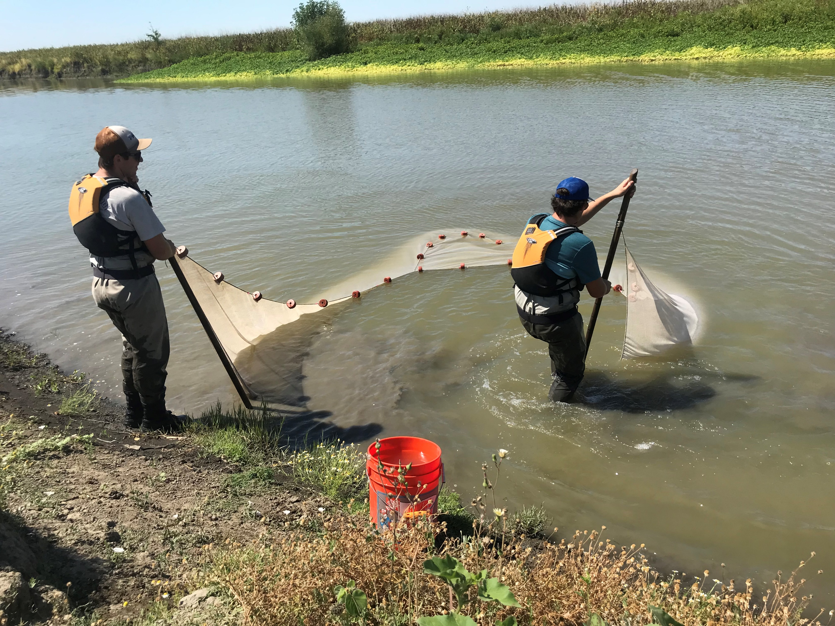
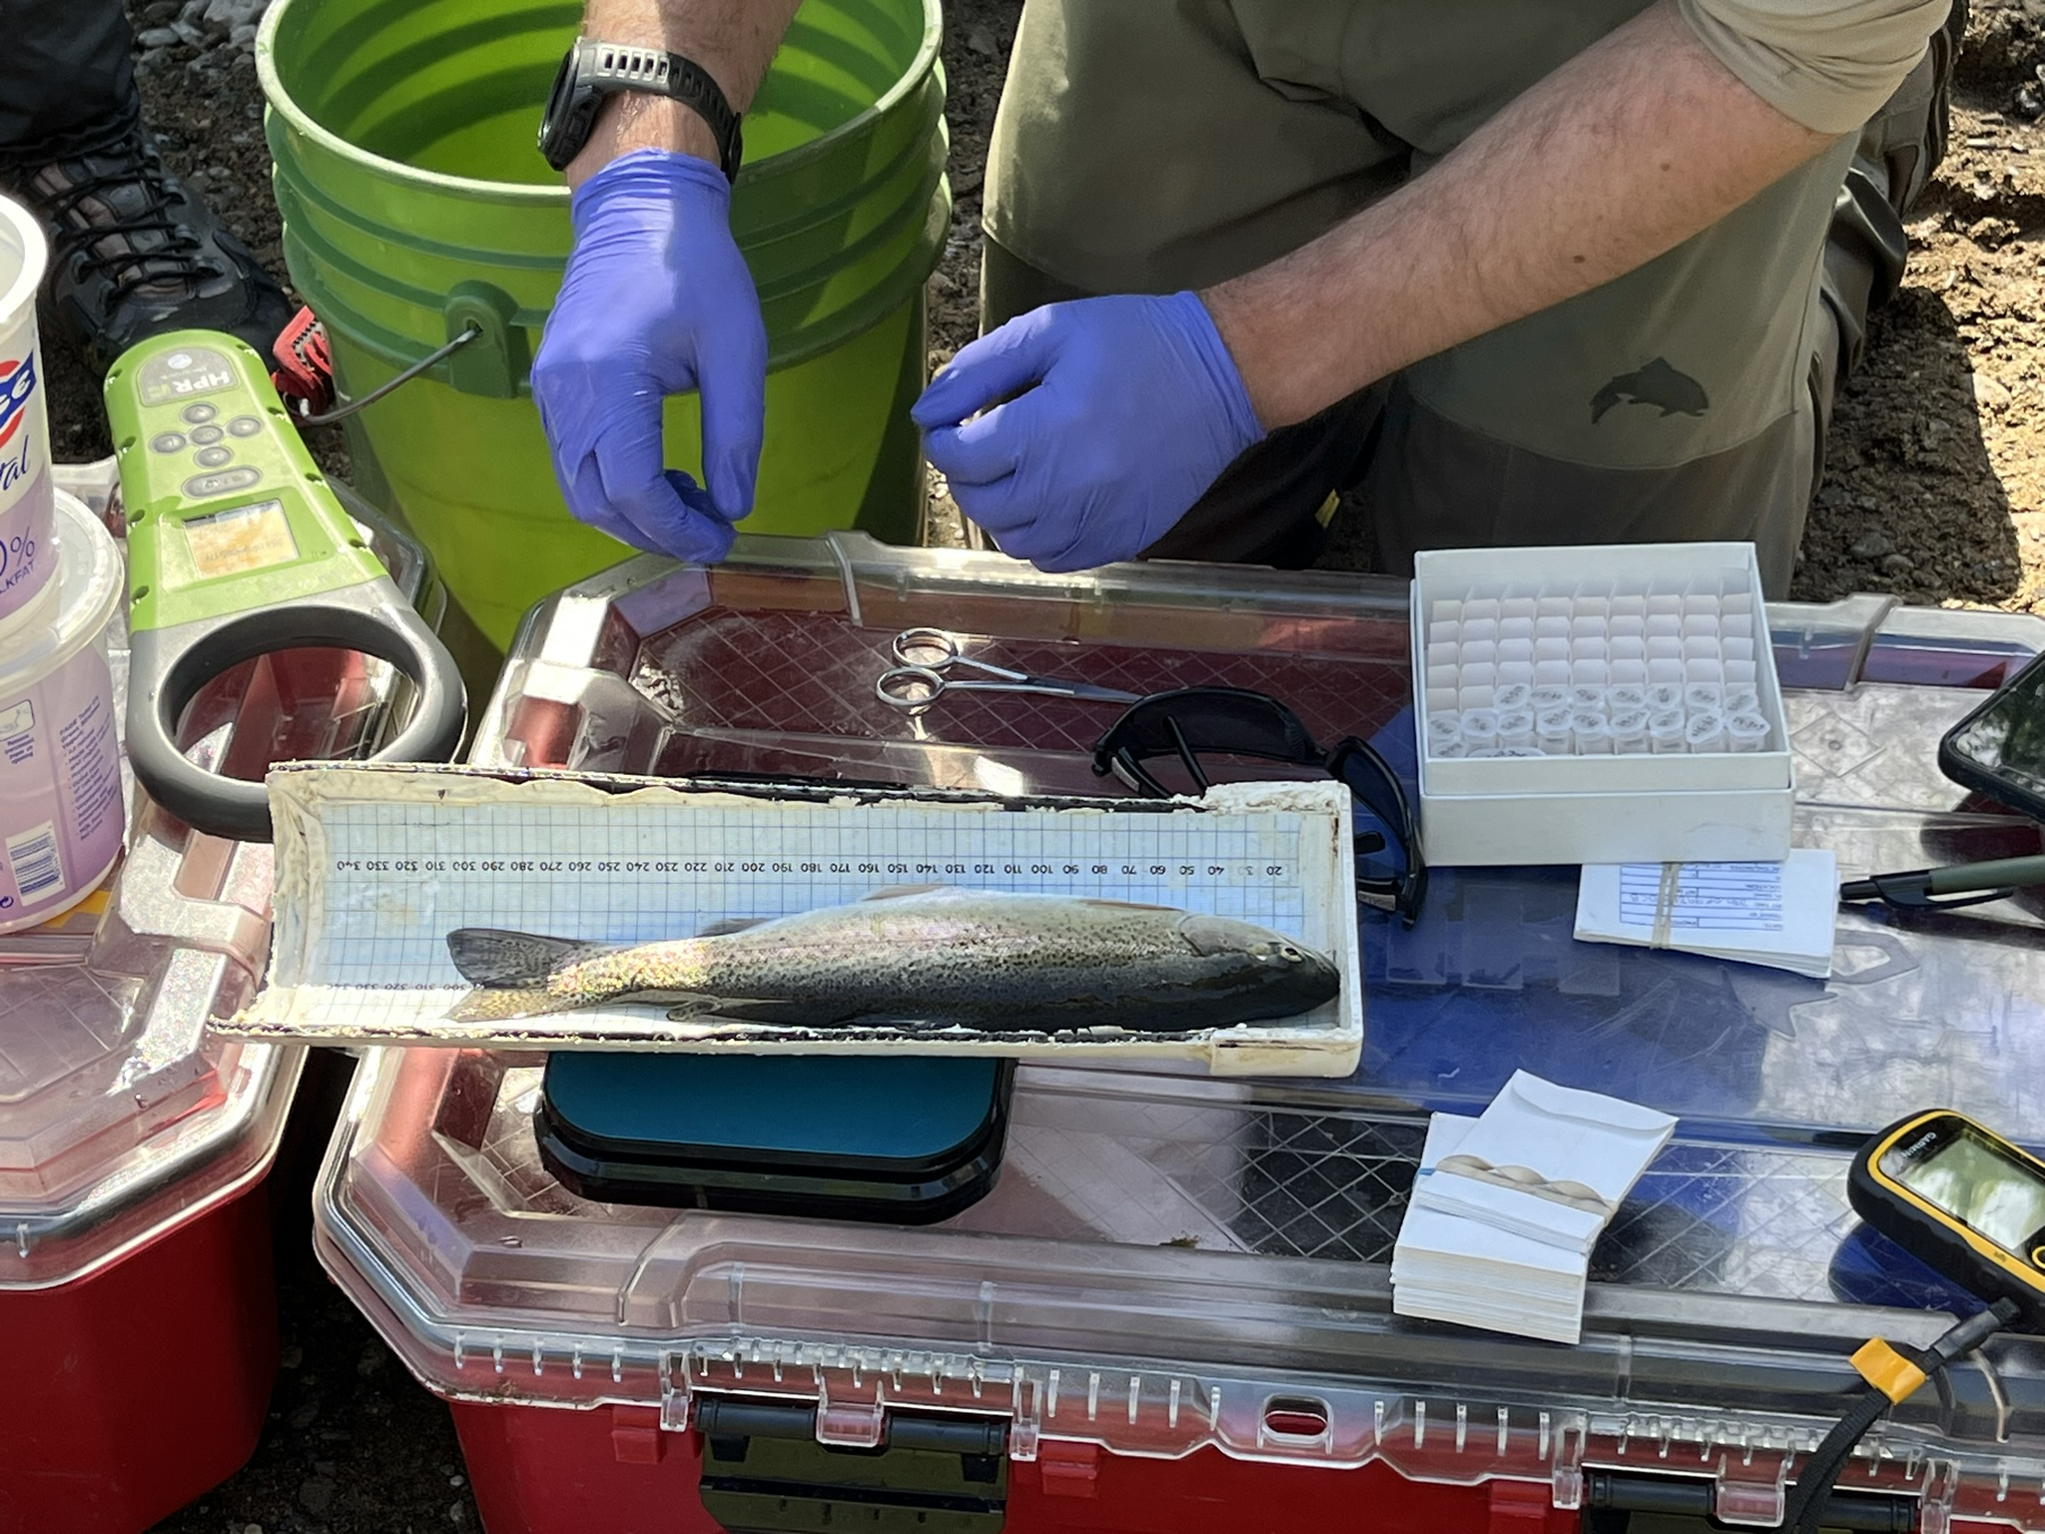
Acquire
Data Management Planning
Data collection
Collect new data
Use, transform existing data

Slide 6
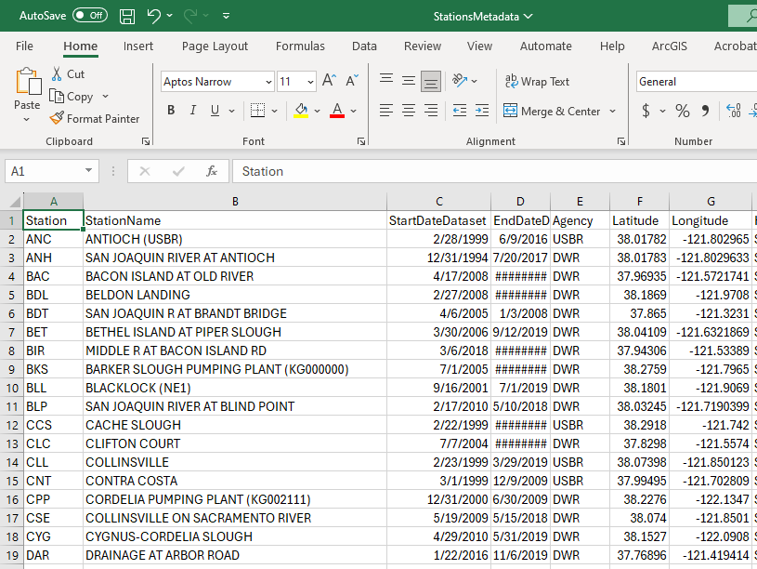
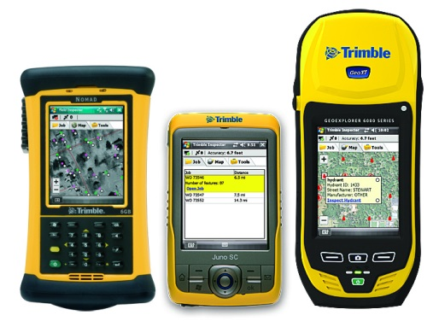
Maintain
Data Management Planning
Data collection
Process data
Check data (QA/QC)
Record/ load data
Rename data
Combine data
Convert data into useable format

Slide 7
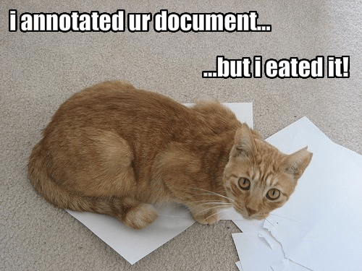
Maintain
Data Management Planning
Data collection
Process data
Description of data (equipment, field and lab procedures, parameters)
Document historical changes and each version’s changes
Document data (metadata)
See Metadata template
See Historical metadata template
More later in the workshop!
https://geoukda.wordpress.com/2011/05/27/progress-update-2/

Slide 8
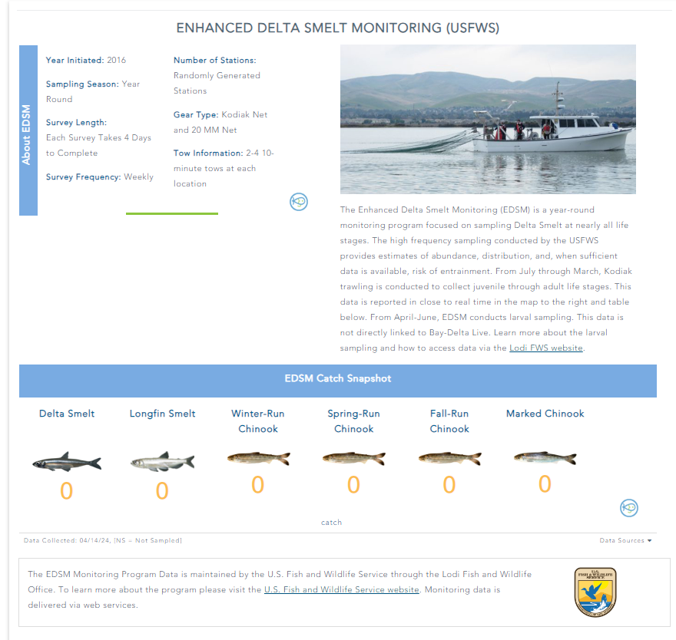

Access
Data Management Planning
Data collection
Process data
Document data (metadata)
See Guidelines for Data Publishing and Formatting
See Instructions for creating metadata for EDI
See EDI Resources for Data Authors
See EDI Resources for Information Managers
Publication of data
Web access
Data portal
Data paper
Reports, Manuscripts
More later in the workshop!

Slide 9
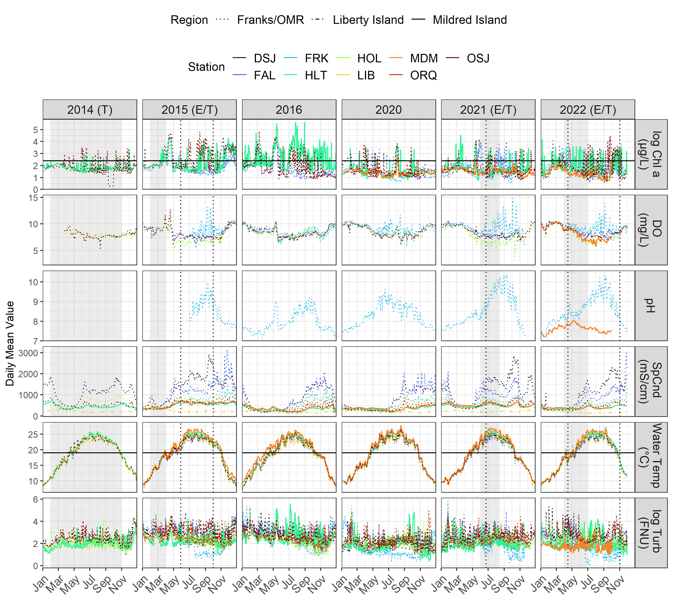
Evaluate
Data Management Planning
Analyze and use data
Develop reproducible workflows
Data collection
Process data
Document data (metadata)
Publication of data
Evaluate data

Slide 10

Archive
Data Management Planning
Data collection
Process data
Document data (metadata)
Multiple copies of data/database
Scanned datasheets (if physical)
Storage in a shared and backed up location
Secure confidential data
Publication of data
Evaluate data
Archive and secure data

Slide 11
Quality Assurance/ Quality Control
Relevant along the entire process
Quality Assurance: Ensuring data quality on the front-end of data collection
Quality Control: Ensuring data quality post-collection
See example SOP template
See Digital Datasheet Best Practices
See example Fish QC Best Practices
See example Code for QC
Coming up next!
Notes:
QA: (defining goals and policies, SOPs, standardized datasheets, training, calibration of equipment)
QC: (Multiple data checkers, rules, outlier detection, formatting)

